Slide 1
Car Price Prediction with Machine Learning Micro-Project #1 https://github.com/juansaracho/Car_Price_Prediction
Juan Saracho
5 February 2023

Slide 2
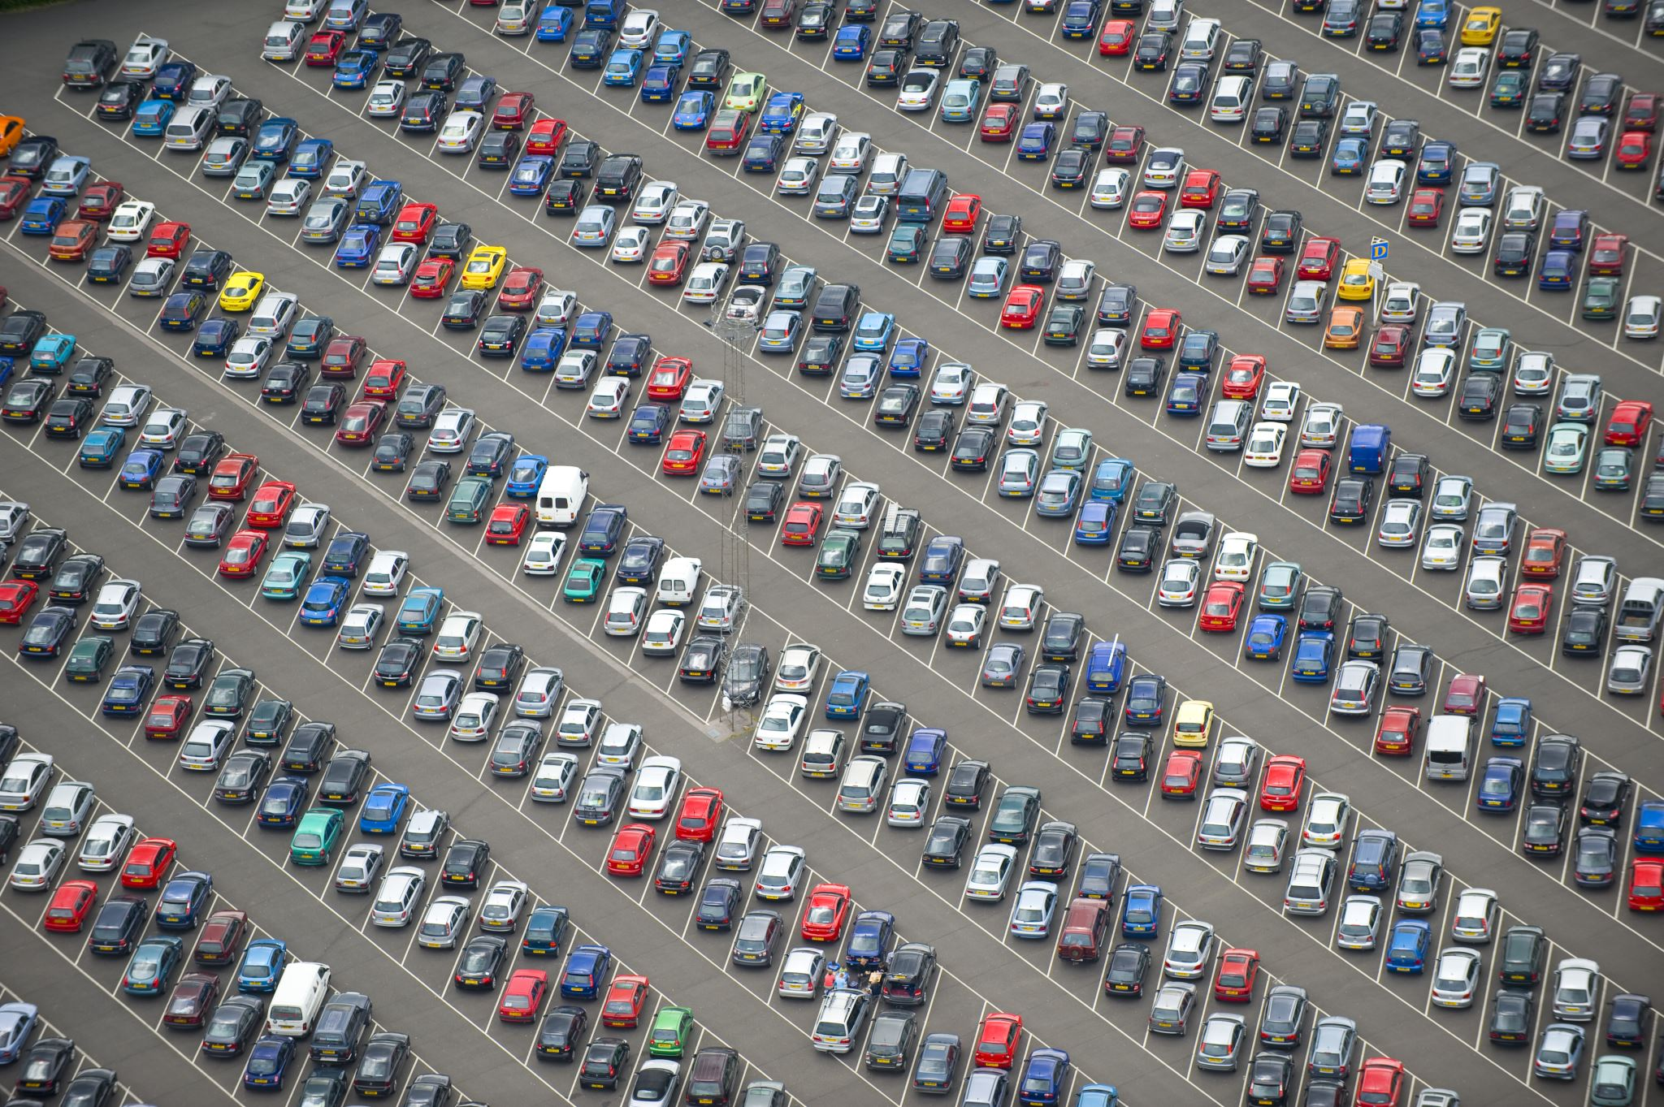
Problem Statement
Background: A 2022 car dataset will be used to analyze which features (or factors) have the largest effect on the value of cars. Additionally, a machine learning regression model will be called to predict the future value of cars.
Objective(s):
What are the factors that have the largest effect on car prices in 2022
Which features (factors) are having the greatest effect on the price of the car?
Which features (factors) are having the least effect on the price of the car?

Slide 3

Hypothesis Formulation
With predictor_features = ['Fuel.Type', 'Gearbox.Type', 'Power.hp', 'Displacement.l', 'Torque.lbft', 'Cylinders', 'Drivetrain', 'MPG.City', 'MPG.Highway', 'Seats', 'Doors', 'Height.in', 'Length.in', 'Width.in', 'Wheelbase.in']
$$H_{0}:The predictor_features have no effect on car prices.$$
$$H_{A}:The predictor_features have positive effect on car prices.$$
The null hypothesis ($H_{0}$) states that the predictor features have no association on the price of a car (dependent variable).
The alternative hypothesis ($H_{A}$) states that the predictor features have a positive effect on the price of cars, e.g., an increase in a car’s horsepower will also increase its price.

Slide 4
Acquire
New Cars data was acquired through Kaggle.com, which is a popular place for data scientists, machine learning practitioners, engineers, and data scientists to post projects, participate in data science competitions and acquire open-source datasets.
Data source: https://www.kaggle.com/datasets/tymekurban/new-cars-usa-202223-dataset?select=cars_us_2022.csv

Slide 5
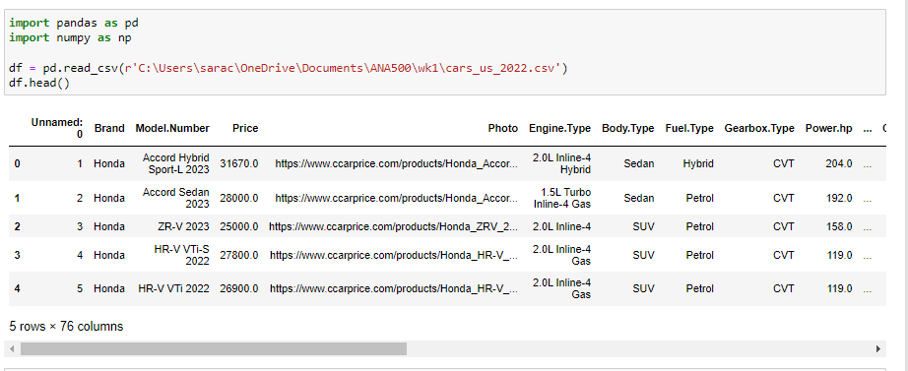
Prepare
‘data.head()’ function outputs the column headers and the first five rows of the dataset

Slide 6
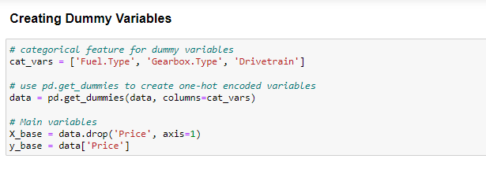
Prepare cont.
‘pd.get_dummies()’ function uses one-hot encoding to transform our categorical variables into binary numeric variables.

Slide 7
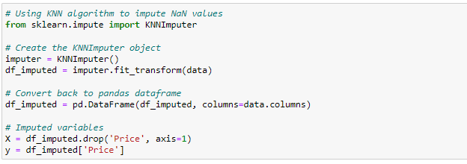
Prepare cont.
‘KNNImputer()’ function uses K Nearest Neighbors algorithm to impute missing values in our dataset.

Slide 8
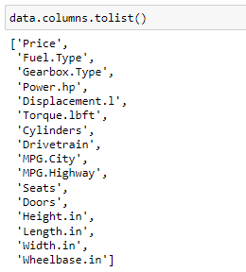
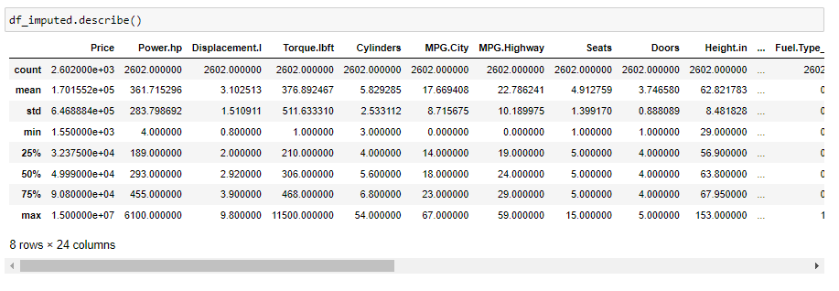
Prepare, cont.
The Data Science Process (2/5)
Features:
Summary stats:

Slide 9
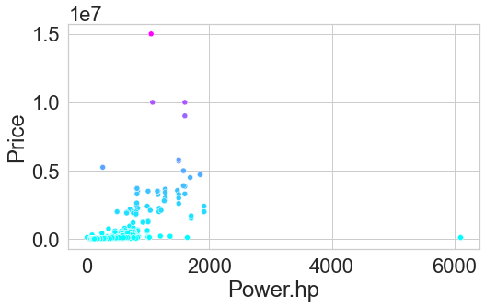
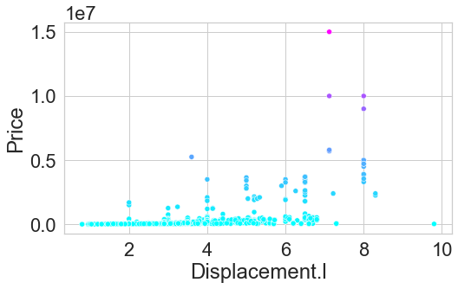
Prepare, cont.
The Data Science Process (2/5)
Visualization of how median car price relates to features

Slide 10
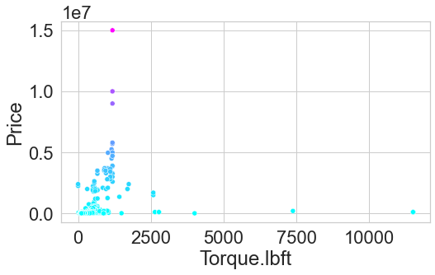
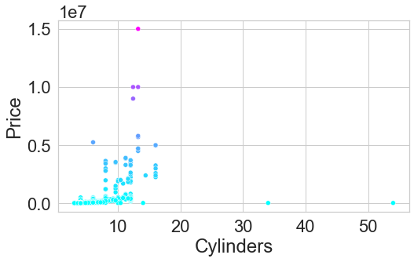
Prepare, cont.
The Data Science Process (2/5)
Visualization of how median car price relates to features

Slide 11
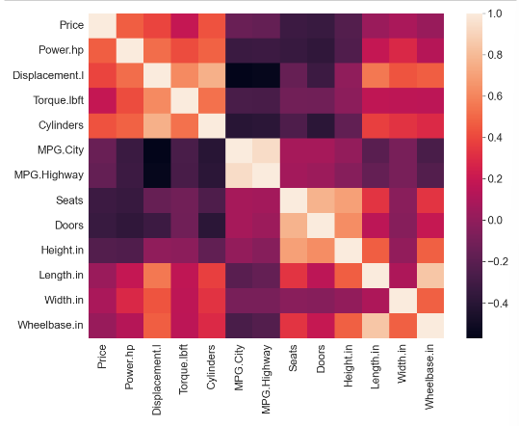
Analyze
Correlation Matrix heatmap created using the corr() and sns.heatmap() functions

Slide 12
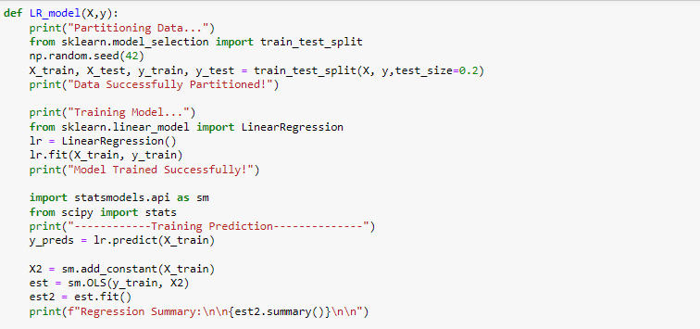
Analyze cont.
We create a function that will partition our data, build our model, train it, and print the results.
Data is partitioned using train_test_split() function.
Use sklearn’s LinearRegression() function to build our model and fit it with our samples.
Use statsmodels OLS() function to create a regression summary.

Slide 13
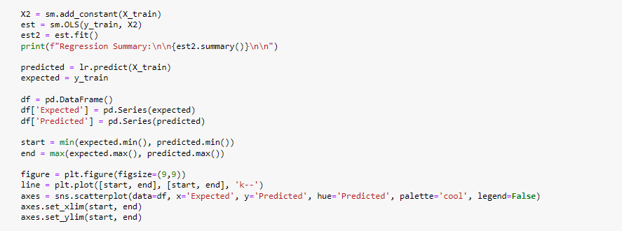
Analyze cont.
Finally, we use seaborn library to create scatterplot that shows our predicted versus our expected values.

Slide 14
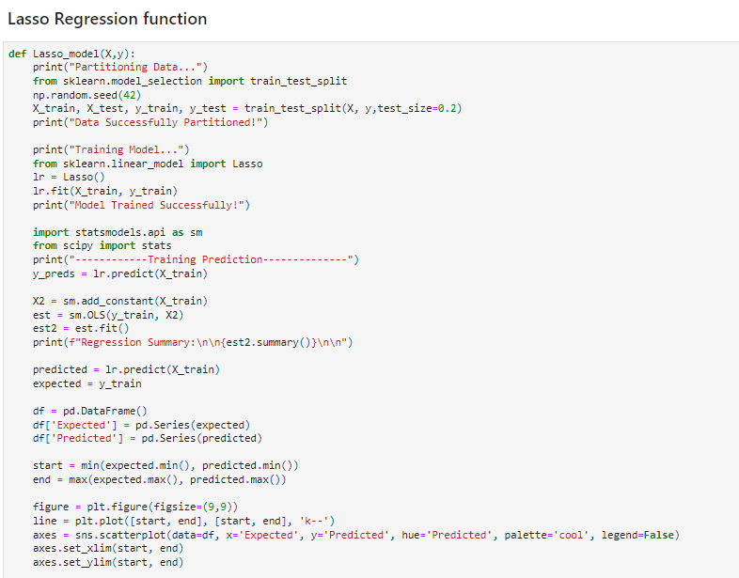
Analyze cont.
Recreate the same function, this time using SciKit Learn’s Lasso() function.

Slide 15
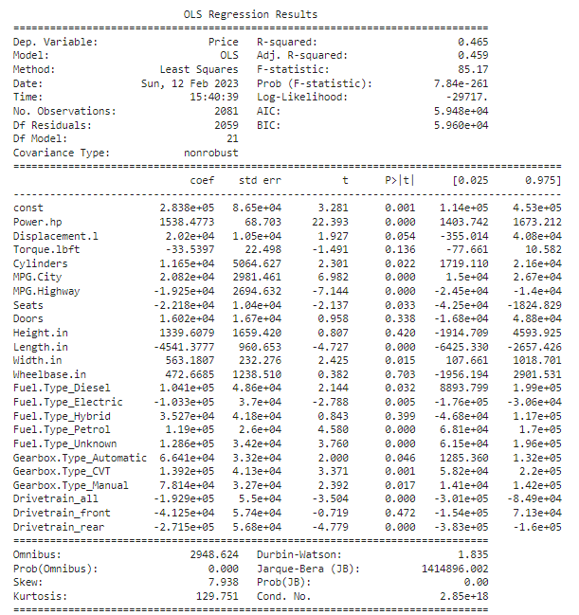
Report
Share our Linear Regression results:

Slide 16
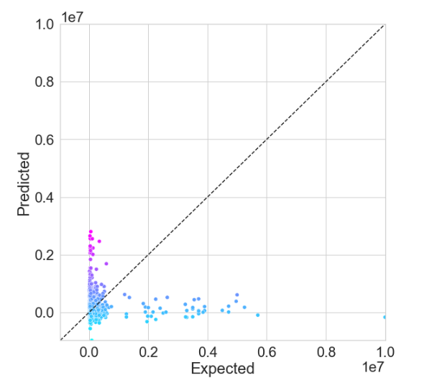
Report cont.
Share our Linear Regression results:

Slide 17
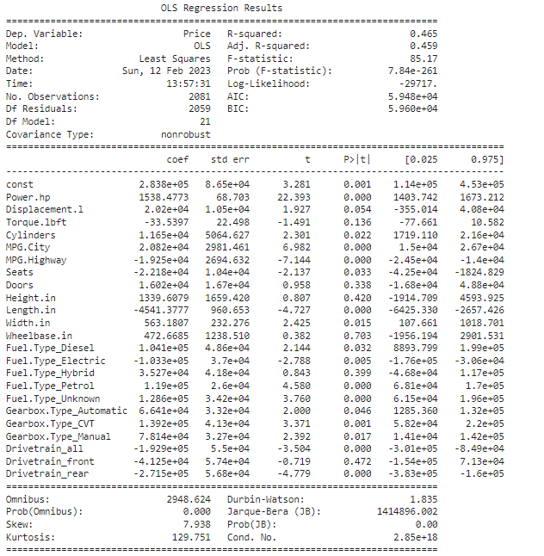
Report cont.
Share our Lasso Regression results:

Slide 18
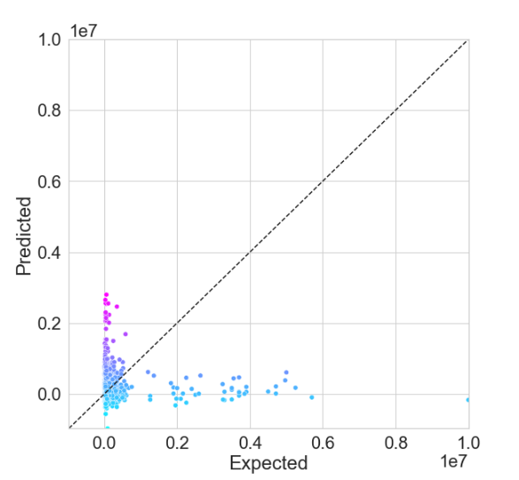
Report cont.
Share our Lasso Regression results:

Slide 19
Act
<apply results, connect results with the chosen problem statement or business question>

